Slide 1
Applied Physics(Com. Sc) BS CS Semester-I Course Code: L-6(Energy) IUB & All Affiliated Colleges. Reality Awards Boost Up (YT-Channel)
Rushmat Ali
Assistant Professor of Physics
Govt. Kh. F. Graduate College R. Y. Khan

Slide 2
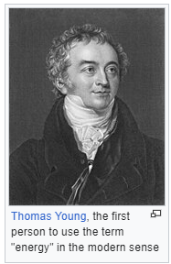
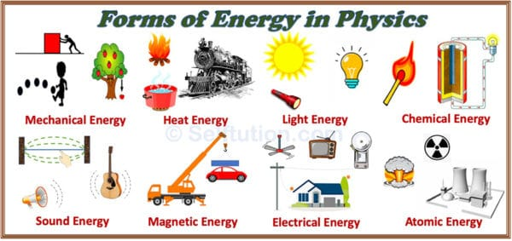
Energy
The ability of a body to do work is called energy.
Energy is a measurement of the ability of something to do work. It is not a material substance. Energy can be stored and measured in many forms. Although work can not be stored.
In physics, energy is the quantitative property that is transferred to a body or to a physical system, recognizable in the performance of work
SI unit joule Other units: kWh, BTU, calorie, eV, erg, foot-pound
Historical Background: The word energy derives from the Ancient Greek: ἐνέργεια, romanized: energeia, lit: activity/operation', the first time in the work of Aristotle in the 4th century BC. Energeia was a qualitative philosophical concept, broad enough to include ideas such as happiness and pleasure.
In the late 17th century, Gottfried Leibniz proposed the idea of the Latin: living force,
In the early 18th century, Émilie du Châtelet proposed the concept of conservation of energy.
In 1807, Thomas Young was possibly the first to use the term "energy" in its modern sense.
Gustave-Gaspard Coriolis described "kinetic energy" in 1829 in its modern sense.
In 1853, William Rankine coined the term "potential energy".
The law of conservation of energy was also first postulated in the early 19th century, and applies to any isolated system.
In 1845 James Prescott Joule discovered the link between mechanical work and the generation of heat.
William Thomson (Lord Kelvin) used heat as the field of thermodynamics.
Thermodynamics aided the rapid development of explanations of chemical processes by Rudolf Clausius, Josiah Willard Gibbs, and Walther Nernst.
The conservation of energy is a consequence of fact that the laws of physics do not change over time.

Slide 3
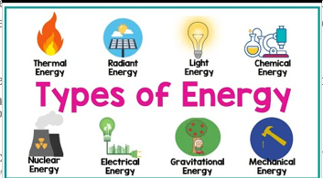
Types of Energy
Mechanical Energy: Energy that results from movement or the location of an object. M.E=K.E. +P.E.
Thermal Energy: It reflects the temperature difference between two systems. A cup of hot coffee has thermal energy.
Nuclear Energy: Energy resulting from changes in the atomic nuclei or from nuclear reactions. Nuclear fission, nuclear fusion, and nuclear decay.
Chemical Energy: It results from chemical reactions between atoms or molecules. Electrochemical energy and chemo-luminescence. Electrochemical cell or battery.
Electromagnetic Energy: Energy obtained by changing electric and magnetic field.
Sonic Energy: Energy of sound waves. A sonic boom, a song played on a stereo, your voice.
Gravitational Energy: Energy associated with gravity involves the attraction between two objects based on their mass. Gravitational energy holds the atmosphere to the Earth.
Radiant/Solar Energy: Energy released from radiation from different sources.
Electrical Energy: Energy produced by the charges.
light energy: Energy derived from the sun used in plants in a process called photosynthesis

Slide 4
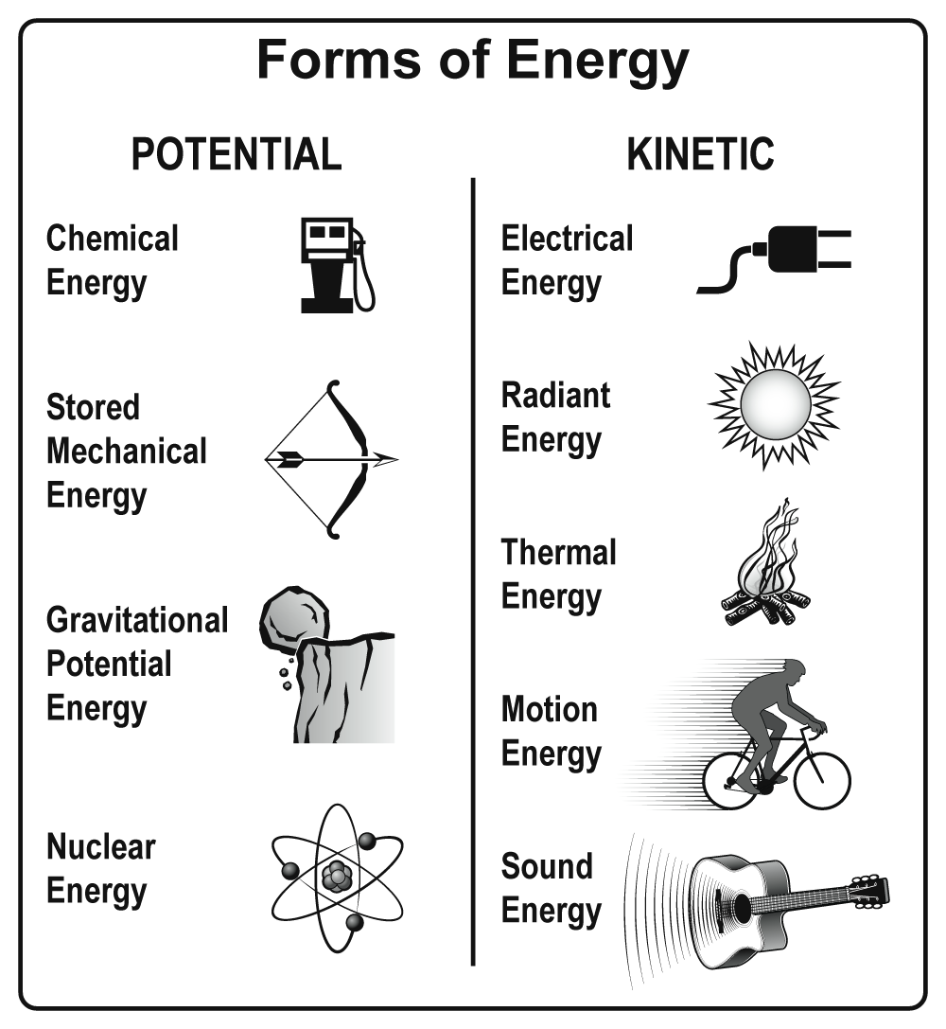
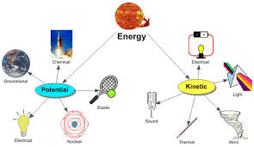
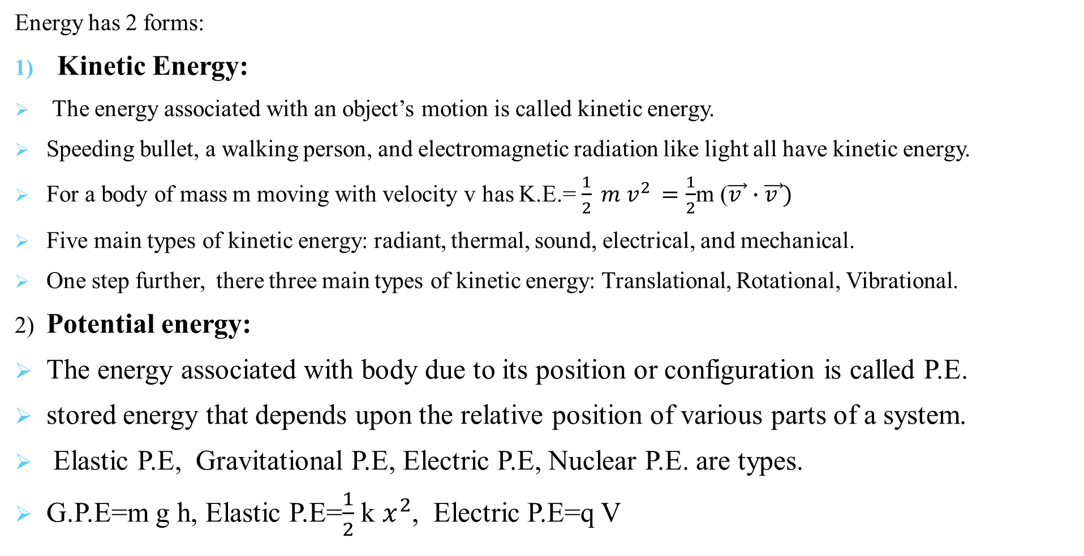
Forms of Energy
Energy has 2 forms:
Kinetic Energy:
The energy associated with an object’s motion is called kinetic energy.
Speeding bullet, a walking person, and electromagnetic radiation like light all have kinetic energy.
For a body of mass m moving with velocity v has K.E.= $\frac{1}{2} m v^{2 }=\frac{1}{2}$m ($\vec{v }∙\vec{v })$
Five main types of kinetic energy: radiant, thermal, sound, electrical, and mechanical.
One step further, there three main types of kinetic energy: Translational, Rotational, Vibrational.
2) Potential energy:
The energy associated with body due to its position or configuration is called P.E.
stored energy that depends upon the relative position of various parts of a system.
Elastic P.E, Gravitational P.E, Electric P.E, Nuclear P.E. are types.
G.P.E=m g h, Elastic P.E=$\frac{1}{2}$ k $x^{2}$, Electric P.E=q V

Slide 5
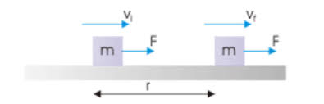
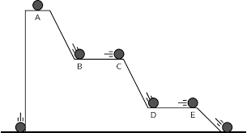
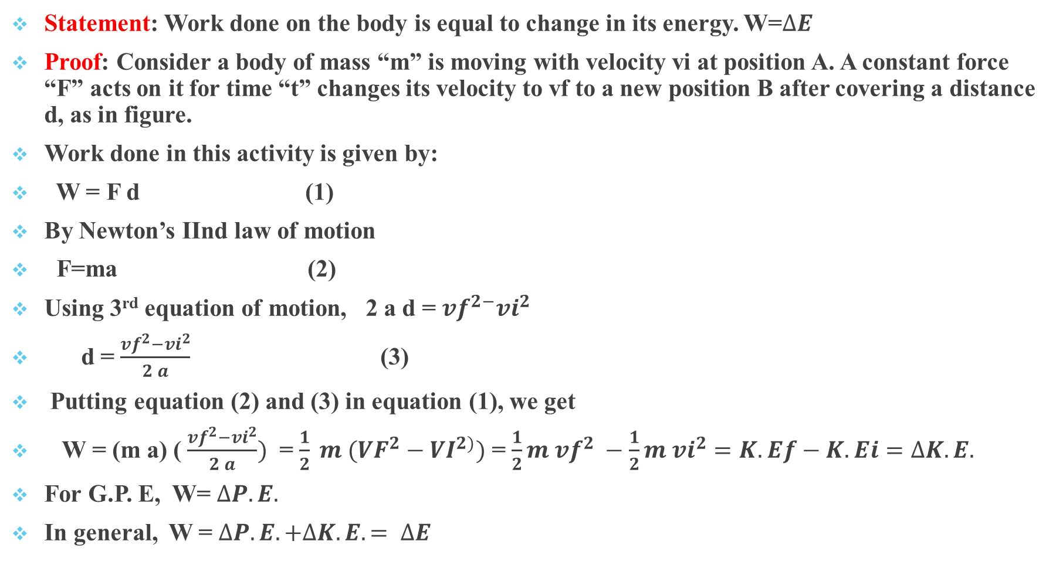
Work-Energy Theorem:
Statement: Work done on the body is equal to change in its energy. W=$∆E$
Proof: Consider a body of mass “m” is moving with velocity vi at position A. A constant force “F” acts on it for time “t” changes its velocity to vf to a new position B after covering a distance d, as in figure.
Work done in this activity is given by:
W = F d (1)
By Newton’s IInd law of motion
F=ma (2)
Using 3rd equation of motion, 2 a d = ${vf}^{2−}{vi}^{2}$
d = $\frac{{vf}^{2}−{vi}^{2}}{2 a}$ (3)
Putting equation (2) and (3) in equation (1), we get
W = (m a) ( $\frac{{vf}^{2}−{vi}^{2}}{2 a})$ = $\frac{1}{2} m ({VF}^{2}−{VI}^{2)})$ = $\frac{1}{2}m {vf}^{2} −\frac{1}{2}m {vi}^{2}=K.Ef−K.Ei$ $=∆K.E.$
For G.P. E, W= $∆P.E.$
In general, W = $∆P.E. +∆K.E. = ∆E$

Slide 6
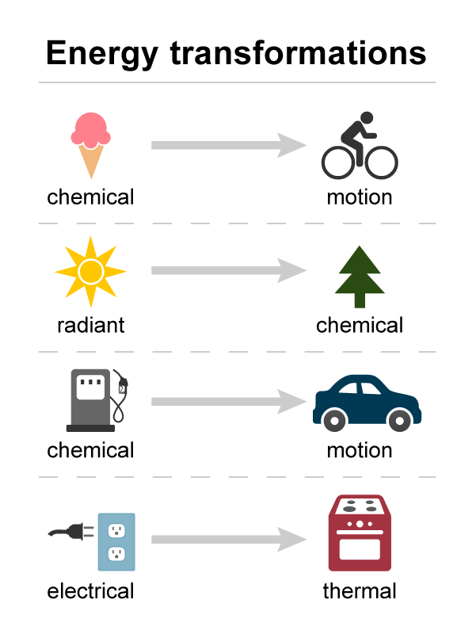
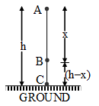
Law of Conservation of Energy
Statement:
It states that energy can neither be created nor be destroyed. Although, it may be transformed from one form to another. If you take all forms of energy into account, the total energy of an isolated system always remains constant.
All the forms of energy follow the law of conservation of energy. In brief, the law of conservation of energy states that
In a closed system, i.e., a system that is isolated from its surroundings, the total energy of the system is conserved.
Derivation
Considering the potential energy at the surface of the earth to be zero. Let us see an example of a fruit falling from a tree.
Consider a point A, which is at height ‘H’ from the ground on the tree, the velocity of the fruit is zero hence potential energy is maximum there.
E = mgH ———- (1)
When the fruit falls, its potential energy decreases, and kinetic energy increases.
At point B, which is near the bottom of the tree, the fruit is falling freely under gravity and is at a height X from the ground, and it has speed as it reaches point B. So, at this point, it will have both kinetic and potential energy.
E = K.E + P.E
P.E = mgX ——— (2)

Slide 7
Law of Conservation of Energy
According to the third equation of motion,
K.E=mg(H-X)——– (3)
Using (1), (2) and (3)
E = mg(H – X) + mgX
E = mg(H – X + X)
E = mgH
Similarly, if we see the energy at point C, which is at the bottom of the tree, it will come out to be mgH. We can see as the fruit is falling to the bottom, here, potential energy is getting converted into kinetic energy. So there must be a point where kinetic energy becomes equal to potential energy. Suppose we need to find that height ‘x’ from the ground. We know at that point,
K.E = P.E
As the body is at height X from the ground,
P.E = mgX ——— (5)
Using (4) and (5) we get,
H/2 is referred to as the new height.

Slide 8
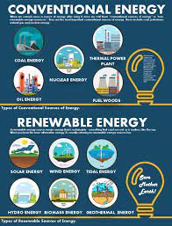
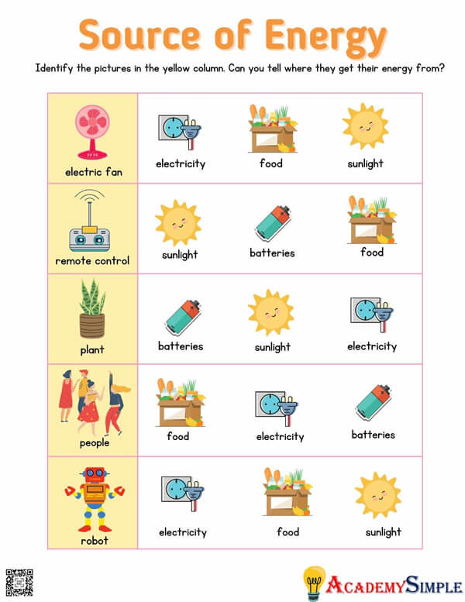
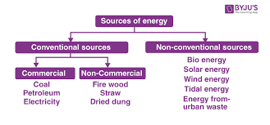
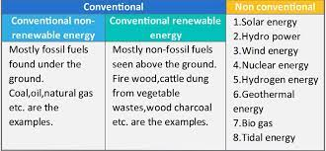
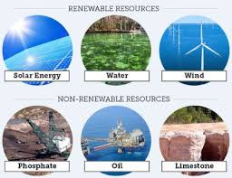
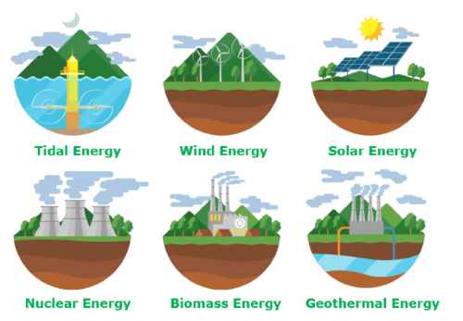
Sources of Energy

Slide 9
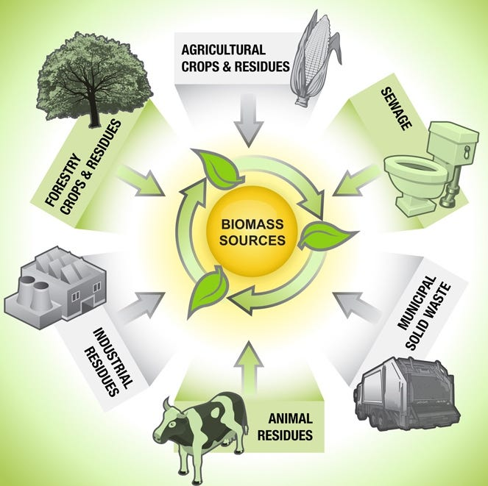
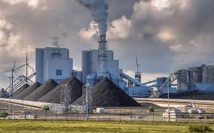

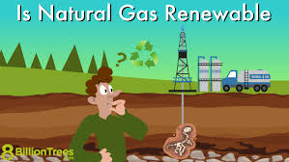
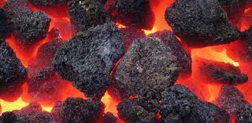
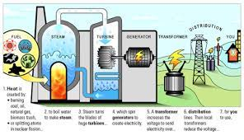
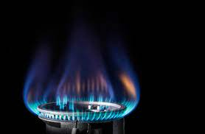
Conventional Sources of Energy
Biomass
A renewable source of energy
Plant and animal waste are their primary sources
Energy from this source is obtained from the breaking of organic molecules during the process of photosynthesis
It can either be used directly or converted into other forms for its convenient extraction
Agricultural crops, forest raw materials, household waste, charcoal, agricultural waste, plant waste, and urban waste are some of its major by-products
Biomass is used in power generation for domestic heating
It is a clean fuel with community heating applications
Burning of biomass releases bio-energy which finds key usage in sustainable development
Coal
There are around 148790 million tonnes of coal deposits in India.
Pakistan is the fourth-largest coal-producing industry in the world.
Coal deposits are mainly in the states of Odisha, Bihar, Madhya Pradesh, and West Bengal.
It features as an employment hub of 7 lakh workers.
Oil and Natural Gas
An important source of energy in India.
Used in automobiles, trains, aircraft, and ships.
states in in Pakistan
Natural gas is a major source of commercial energy supply in Pakistan and its consumption has a large share in commercial energy use.
In Pakistan, natural gas was discovered approximately 60 years ago. These discoveries prompted the government and the gas utilities to install large gas transmission and distribution networks.
Pakistan opted for providing piped gas to all types of consumers right from the outset

Slide 10
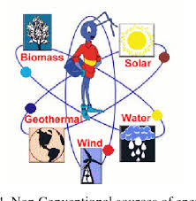

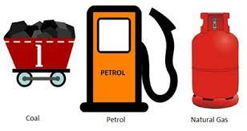
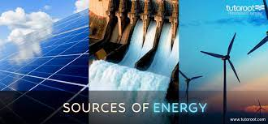
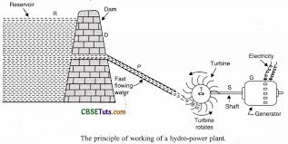
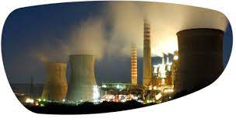
Difference b/w Conventional and Non-conventional sources
Conventional Sources of Energy
These are natural sources of energy available for a limited time period
Non-renewable in nature, these sources shall get depleted with the passage of time
Usually obtained from decaying matter which was formed over millions of years ago
Continual exploitation of these resources have deteriorated them to a great extent
For example, coal is a conventional source of energy, overused and exhausted
According to researchers, coal may not last for more than 100 years if used judiciously
Other than coal, biomass natural gas and petroleum are some conventional sources of energy
These sources cause environmental damage and contribute to global warming
Commonly used for commercial and industrial purposes
Non-conventional Sources of Energy
These energy sources are eligible for continuous replenishment via natural processes
Inexhaustible in nature, these sources can be iteratively generated and long-lasting
These sources are renewable as the energy generated from them can be substituted with natural processed
Energy obtained from these resources is referred to as non-conventional energy.
They do not cause environmental pollution
These sources do not incur heavy expenditure.
Famous examples:Tidal energy, wind energy, hydel energy, solar energy, and geothermal energy.

Slide 11
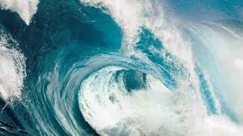
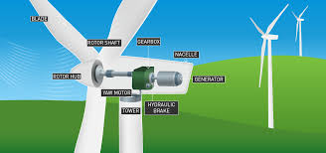
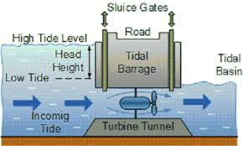
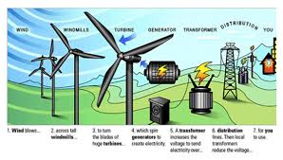
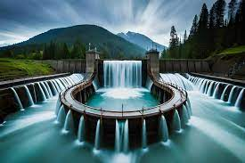
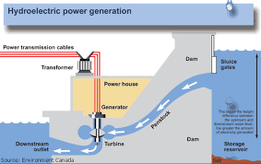
Non-Conventional Sources
1) Tidal Energy
It harnesses the energy from the upward and downward moving tidal waves.
To generate energy from tides, the tidal range must be above 5 m.
To extract energy from this source, a dam is built across the shore of the tides.
This dam is usually constructed around a bay or an estuary in order to form a reservoir for energy collection.
With the rise of tides, the dam opens its gates to allow the seawater to enter.
This further turns the blades of the installed turbines and eventually results in the generation of electricity.
As soon as the tide falls, the gates of the dam are shut to the falling water while keeping the flowed-in water still intact.
In this way, energy is harnessed from the rising and falling tides.
This building of dams across the tidal power venues adversely impacts the vegetation and wildlife of that area.
2) Wind Energy
It is produced by harnessing wind power.
Mainly advantageous for the purpose of irrigation.
It is a free and clean source of energy.
These may be hazardous for birds and flying planes.
It may not be available everywhere.
3) Hydel Energy
It utilizes the kinetic energy of mobile water to generate power.
It is a cheaper source of energy as compared to geothermal and nuclear energy.
To harness hydel energy, highly elevated dams are built across the rivers and the water falling on the dams generates hydropower.
It is an inexpensive and clean source of energy.
However, the building of dams drastically impacts the natural habitat of that region and also leads to the forced migration of the local population.
In short, it impacts the entire ecosystem of the location where hydel projects are undertaken.

Slide 12
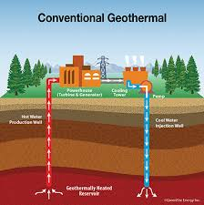
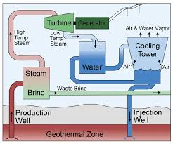
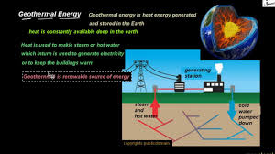
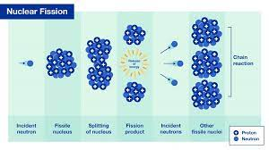
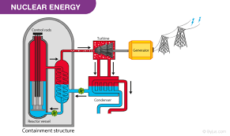
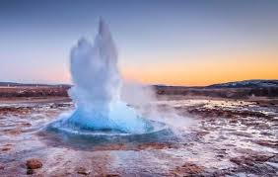
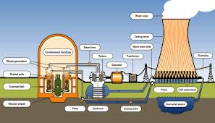
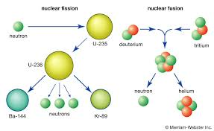
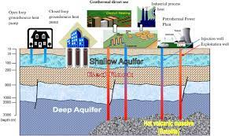
Non-Conventional Sources
4) Geothermal Energy
Natural heat from the Earth’s interiors can also be useful to generate electricity.
The hot energy captured inside and sustained within the Earth helps in the harnessing of geothermal energy.
It can be extracted from areas prone to volcanoes, or areas located deep within the oceanic surface, hot springs and geysers.
In India, the Himalayan belt and the western coast are important geothermal energy generation regions.
Puga Valley in Ladakh is an essential source of geothermal energy.
At times, this source of energy can engender environmental problems such as emission of harmful gases like hydrogen sulphide and noise pollution at the geothermal site.
5) Nuclear Energy
The primary fuel for nuclear power plants is uranium.
Pakistan has 2 main nuclear power plants: at KANUP (R, Kapco.
Nuclear energy is generated through the electrochemical processes of fission and fusion.
It contributes around 3% of the total energy generation in India.
It is an eco-friendly and fuel-efficient source of energy.
However, it may be hazardous as nuclear accidents cause wide-ranging damage and loss.
There also exists a problem with the safe disposal of nuclear wastes.
The End

